Slide 1
Growing Churches Through Sabbath School Classes: A Relational Approach
J. Alfred Johnson, II
Director of Adult Ministries
North American Division
www.nadadultministries.org
Copyright © 2019 J. Alfred Johnson II

Slide 2
PART 1
GETTING STARTED:
WHAT IT’S ALL ABOUT!

Slide 3
What Is Sabbath School?
Relational,
Small Group -Driven,
Seventh-day Adventist
Local Church
Educational Fellowship…

Slide 4
What Is Sabbath School?
. . . that Builds
Faith and Practice
In The Context of
The Three Goals of
Sabbath School.

Slide 5
THE Three GOALS OF SABBATH SCHOOL

Slide 6
SABBATH
SCHOOL
BIBLE
STUDY
FELLOWSHIP &
NURTURE
LOCAL & WORLD
MISSION

Slide 7
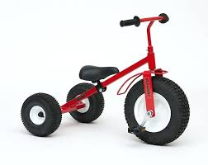
Balanced Sabbath School
Must Include
These Elements:
Bible Study
Local & World Mission

Slide 8
Balanced Sabbath School
Fellowship and Nurture

Slide 9
Faith and Practice
Faith =
Knowledge of the Bible, and
Personal Relationship
With Jesus (“Know-Be”)

Slide 10
Faith and Practice
Practice = Application
Of “Faith” In The Context Of Living and Witnessing
With Jesus (“Do”)

Slide 11
Relational Approach?
“Focus On
Being Responsive
To People and Their Needs”

Slide 12
Relational Impact
People Will Tend To Be
Enthusiastically and
Beneficially
Active In Sabbath School
To The Degree That Their
Needs Are Being Met

Slide 13
What If?
We Structured Sabbath School To Address The Baseline Evangelism and Nurture Agenda Of The Congregation – Focusing On Needs Of People?

Slide 14
What If?
We Formatted Time Usage In Sabbath School To Accomplish This?

Slide 15
What If?
We Made Sabbath School So Meaningful -- That People Would Rush To The Experience?

Slide 16
What If?
The Spirit Of Positive, Joyful, Sabbath School Lasted All Week?

Slide 17
Are You Willing?
To Prayerfully Advocate
For Adjustments
If
The Adjustments Will Be Beneficial?

Slide 18
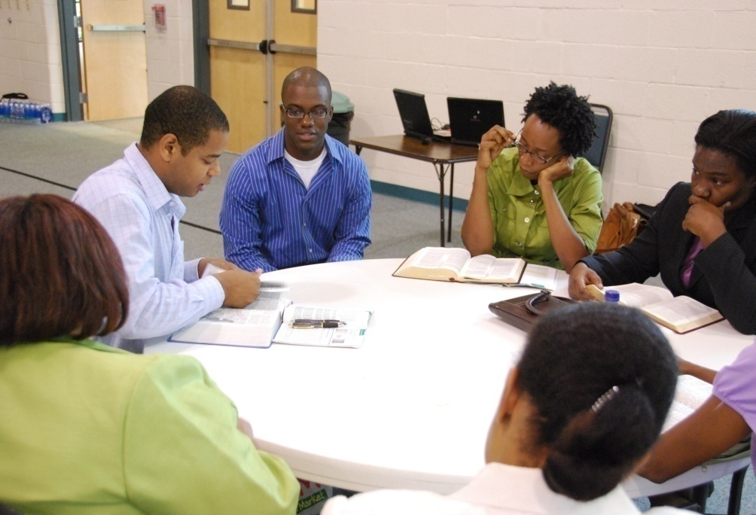
We Are Dedicated To Facilitating Sabbath School Classes As Holistic, Relational: “SMALL GROUP FAMILIES”

Slide 19
STUDY – NURTURE – FELLOWSHIP
Small Group Families

Slide 20
PRAYER – RECLAMATION
Small Group Families

Slide 21
LOCAL OUTREACH / WORLD MISSION FOCUSED
Small Group Families

Slide 22
Small Group Families
Not “Classes”
with “Teachers”
who only
“Guide Bible Study”
But . . .

Slide 23
Small Group Families
. . . “Weekly Family Reunions”
Led By
“FACILITATORS”,

Slide 24
Small Group Families
“FACILITATORS”
who Guide
The Small Group Process.

Slide 25
What Is A Facilitator?
Webster:
“A Person Responsible For Leading Or Coordinating The Work Of A Group”

Slide 26
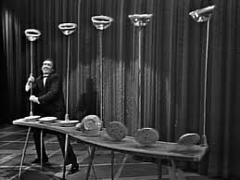
What Is A Facilitator?
Illustration –
“Ringling Brothers”
Plate Spinner

Slide 27
What Is A Facilitator?
“One Who Helps
Get Things
Started, and Assists In
Keeping Them Going

Slide 28
Ideal Facilitator Qualities
Kind; Caring; Christian Seventh-day Adventist
Friendly; Unselfish; Good Listener

Slide 29
Ideal Facilitator Qualities
Positive Personality; Respectful
Capable Of Living and Leading The Study Of
“The Word” (If Teaching)

Slide 30
Ideal Facilitator Qualities
Has A Focus On
Transformational Learning
(“Know-Be-Do” )

Slide 31
The “Ideal” Facilitation Atmosphere
Family Sits In A Circle
(If Possible)
No Podium

Slide 32
Facilitator Sits With People! – This Provides For
“Eye Contact” and Ease
Of “Body Language”
Communication

Slide 33
Partners In Ministry,
Be Assured Of Our Prayers As you Continue To Submit Your Gifts To Christ For The Strengthening and Growth
Of Your Congregation!

Slide 34
Growing Churches Through Sabbath School Classes: A Relational Approach
J. Alfred Johnson, II
Director of Adult Ministries
North American Division
www.nadadultministries.org
Copyright © 2019 J. Alfred Johnson II

Slide 35
Relational Sabbath School: Working The Process!
PART 2

Slide 36
Small Group Families
Nurture
Welcome and Greet Everyone By Name

Slide 37
Small Group Families
Nurture
- 1st Question, “What Kind Of Week Did You Have?”

Slide 38
Small Group Families
Nurture
- Time For Testimonies and Prayer Requests

Slide 39
Small Group Families
Nurture
- Organize To Contact ALL in the group By Tuesday!

Slide 40
Small Group Families
Prayer Emphasis
- Family Takes Time For Prayer Ministry

Slide 41
“The greatest victories
gained for the cause of
God are not the result of
labored argument, ample
facilities, wide influence, or
abundance of means; . . .
Gospel Workers, 259
(Italics and Other Emphasis Supplied)

Slide 42
They are gained in the
audience chamber with
God, when with earnest
agonizing faith men lay
hold upon The Mighty Arm
Of Power.”
Gospel Workers, 259
(Italics and Other Emphasis Supplied)

Slide 43
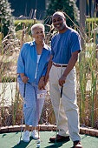
Small Group Families
Fellowship Emphasis
- Most Sabbath School
Setups Are Not “Interaction
Friendly”.

Slide 44
Small Group Families
Fellowship Emphasis
- Difficult To “Read” and
“Feel” People By Looking
At The Backs Of
Their Heads

Slide 45
Small Group Families
Fellowship Emphasis
- Balance With Monthly Fellowship Activities

Slide 46
Small Group Families
Fellowship Emphasis
- Plan During Small Group Family Time!

Slide 47
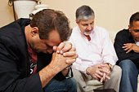
Small Group Families
Reclamation Emphasis
- How Many Churches Have No Need Here?

Slide 48
Small Group Families
- SS Secretary Gets List From Church Clerk
- List Is Divided Equally Between Families
- No Contact Is Made! ONLY PRAYER!

Slide 49
Small Group Families
Reclamation Emphasis
- Then Watch Our Lord Bring Them Back!

Slide 50
Small Group Families
Bible Study Emphasis
- Begin With, “What
Portion Of Your Study
Blessed You Most, and
Strengthened Your
Witnessing Capacity?”
(“So What Factor”)

Slide 51
Small Group Families
Bible Study Emphasis
- Then Move To Other Points In The Lesson

Slide 52
Small Group Families
Bible Study Emphasis
- Emphasize That We
Study For Knowledge
That Leads To
Relationship and
Action! (“Know-Be-Do”)

Slide 53
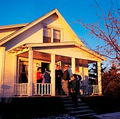
Small Group Families
Local Mission /
(Community Outreach)
- Emphasize We Are Here To “Know-Be-Do”!

Slide 54
Small Group Families
Community Outreach
- Determine The Family “Corporate Spiritual Gift Cluster” (Common Ministry Areas For Most Family Members).

Slide 55
Small Group Families
Community Outreach
- Offer The “Common Ministry” To The Church Through Sabbath School

Slide 56
Accomplish This Format:
Consider Minimizing “Program” Time AND Maximizing “Small Group Family/ Class” Interaction Time!

Slide 57
Ideal “Family” Size?
How About The Number
Selected By Jesus?
Spawn New Families
When Growth
Is About 20!

Slide 58
Organize The Family: Each Has a “1, 2 & 3”
1. Lead/ Facilitator (#1)
2. Associate Lead/ Facilitator (#2)
3. Assistant Lead/ Facilitator (#3)

Slide 59
Spawning A New Family:
The original Lead (#1) becomes the Lead for the new Small Group Family.
The original Associate Lead (#2) becomes the Lead for the original Small Group Family.

Slide 60
Spawning A New Family:
The original Assistant Lead (#3) becomes the Associate Lead of the original Small Group Family.

Slide 61
Spawning A New Family:
Select NEW Associates and Assistants to fill remaining positions.

Slide 62
Partners In Ministry,
Be Assured Of Our Prayers
As You Continue To
Submit Your Gifts To Christ
For The Strengthening
and Growth in Your Congregations!

Slide 63
Growing Churches Through Sabbath School Classes: A Relational Approach
J. Alfred Johnson, II
Director of Adult Ministries
North American Division
www.nadadultministries.org
Copyright © 2019 J. Alfred Johnson II

Slide 64
PART 3
Pathways To
Successful Relational
Sabbath School Bridges

Slide 65
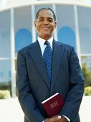
Effective Leader/ Facilitators Pastors & Members Stand At The Core Of This Effort

Slide 66
1. Daily Baptism Of The Holy Ghost
Be Certain YOU
Pray For A
“Baptism Of The
Holy Ghost”
EVERY DAY!
Acts 1:8

Slide 67
Power To Function
Holy Ghost “WITHIN/ IN US” = Power To “BE”
Fruit Of The Spirit!
Galatians 5:22, 23
Grows The Character of Christ Within Us!

Slide 68
Power To Function
The Holy Ghost “UPON US” = Power To “DO”
Acts 1:8

Slide 69
2. Love Your Ministry!
Show The
“Family Members”
They Are Cared For!

Slide 70
2a. Acknowledge and Practice “The Nelson Principle”

Slide 71
“Family Members” Are More Likely To Function At High Levels When They Sense That Their “Family Members” CARE For Them!

Slide 72
2b. “The Nelson Principle” Applied
Learn Their Names
(3 John 14 – “Greet the friends by Name.”)

Slide 73
2b. “The Nelson Principle” Applied
Communicate During
The Week

Slide 74
2b. “The Nelson Principle” Applied
Assure Them Of Your Prayers For Them!

Slide 75
3. Acknowledge and Respond To Four Basic Human Needs
NEW EXPERIENCES
SECURITY
RESPONSE
RECOGNITION

Slide 76
Four Basic Human Needs
RECOGNITION –
Validates
“Personhood” and
“Presence” In The Group

Slide 77
Four Basic Human Needs
RESPONSE –
Validates The “Person” As A “Contributor and Participant”

Slide 78
Four Basic Human Needs Applied
NEW EXPERIENCES – “Expand” The Horizons
Of The Person and
The Group

Slide 79
Four Basic Human Needs Applied
SECURITY –
Engenders “Confidence”

Slide 80
4. Have A Good Attitude!

Slide 81
4a. Be Mindful That EVERYONE Projects A “Personal Atmosphere” Be Sure Yours Is POSITIVE!

Slide 82
4b. “Personal Atmosphere” The “Ten Foot Principle”

Slide 83
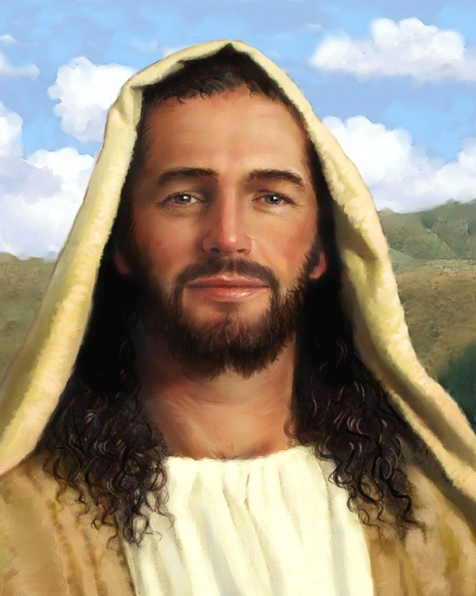
4c. Be POSITIVE!
What are the chances that many people will be led to Christ BY PEOPLE WHO ARE NEGATIVE?

Slide 84
5. Discover and Facilitate Meeting The Needs Of “Family Members”

Slide 85
The Needs Of Family
Physical
Spiritual
Social

Slide 86
Your Church Will Grow When Sabbath School Attendees:
Are Loved, Valued, Appreciated and Respected!

Slide 87
Your Church Will Grow When Sabbath School Attendees:
Are Encouraged To Share and Serve!

Slide 88
Your Church Will Grow When Sabbath School Attendees:
Experience Their
Needs Being Met!

Slide 89
Your Church Will Grow When Sabbath School Attendees:
Have Fun and Fellowship!

Slide 90
Your Church Will Grow When Sabbath School Attendees:
Sense They Are In A Secure Environment!

Slide 91
Your Church Will Grow When Sabbath School Attendees:
Experience The Goals of Sabbath School Packaged In A Relational Way!

Slide 92
Concluding Thoughts
“Sabbath School
Small Group Families”
-Not Classes

Slide 93
Concluding Thoughts
“Facilitators”
- Guide The Small
Group Process!

Slide 94
Concluding Thoughts
“Teachers”
- Guide Bible Study

Slide 95
Concluding Thoughts
“Relational Emphasis” -- Targeted To People and Their Needs Through Caring Interaction

Slide 96
Concluding Thoughts
Minimize Program and Maximize “Family Time”

Slide 97
Concluding Thoughts
Balance Evangelism and Nurture By Applying The Goals Of Sabbath School In A Relational Way!

Slide 98
Resources
The Adult Ministries Website IS HERE at: www.nadadultministries.org

Slide 99
Resources
www.adventsource.org:
Sabbath School, Personal,
Prison Ministries
Quick Start Guides
and Catalogues

Slide 100
Resources
NAD “Eight Course” Sabbath School Teacher Training Curriculums
NAD “Nine Course” Personal Ministries Participant Curriculum
Both Curriculums Available
on www.nadadultministries.org at no charge
or
at www.adventsource.org

Slide 101
Resources
www.sabbathschoolpersonalministries.com
International Institute of Christian Ministries

Slide 102
Resources
Google –
“Cool Tools for Sabbath School”
@NADAdultMIN on: Twitter/Facebook/Instagram

Slide 103
Resources
Sabbath School Tool Box –
www.pacificpress.com
Sabbath School 4 In The App Store

Slide 104
Resources
“Sabbath School Lesson” on Amazon Alexa and on www.nadadventist.org

Slide 105
Partners In Ministry,
Be Assured Of Our Prayers
As You Continue To
Submit Your Gifts To Christ
For The Strengthening
and Growth Your Congregation!

