Slide 1
PERSONAL MINISTRIES RESOURCES
A PERSONAL MINISTRIES LEADERSHIP SEMINAR
Presented by
J. Alfred Johnson II
Director Of Adult Ministries
North American Division
June 11, 2018
South Atlantic Conference Of Seventh-day Adventists

Slide 2
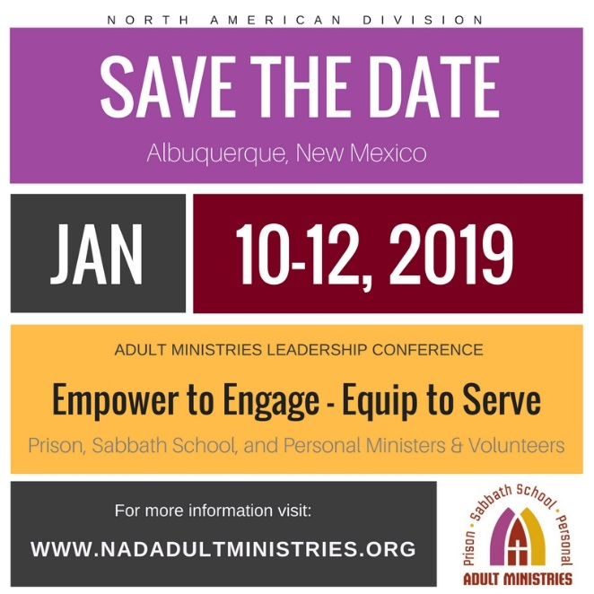

Slide 3
Personal Ministries
Mission, Purpose and Organization

Slide 4
What is Personal Ministries?
Personal Ministries is the name of a department sponsored by the Seventh-day Adventist church,
Also a designation for any ministry carried out by individual members, or small groups of people, focused on direct evangelistic contact,
Such as Bible studies, baptismal classes, and church member-led evangelistic efforts, or other methodologies involving direct soul winning outreach.

Slide 5
Purpose
The purpose of Personal Ministries is to recruit as many church members as possible for involvement in direct soul winning activities.

Slide 6
Core Methodology
“Christ’s method alone will give true success in reaching the people. The Saviour mingled with men as one who desired their good. He showed His sympathy for them, ministered to their needs, and won their confidence. Then He bade them, 'Follow Me.’”
Ellen G. White, The Ministry of Healing, p. 143.

Slide 7
Resources
Nadadultministries.org
Facebook and Twitter - @AdultMinNAD
Sabbath School Tool Box – Pacificpress.com
Personal Ministries Participant and Sabbath School Teacher Training Curriculums on www.nadadultministries.org
AdventSource
Personal, Prison and Sabbath School Resources

Slide 8
Personal Ministries Training System
Core Units
The Great Commission: The Call to Be Fishers of People
Introduction to the Bible.
How to Interpret the Bible and the Writings of Ellen G White.
Notes:
felstvalofthelaity

Slide 9
Personal Ministries Training System
Essential Skills
The Science of Soul Winning: Methodologies, Resources, Basic Skills.
How to Give Bible Studies.
The Art of Obtaining Decisions.
Reaching and Winning Christians of Various Persuasions.
Reaching and Winning Non—Christian People.
Finishing the Core Unit and Essential Skills = “Qualified Personal Ministries Participant”
Notes:
felstvalofthelaity

Slide 10
Personal Ministries Training System
Member—Led Public Evangelism
The Basics of Evangelistic Sermon Preparation and Delivery.
How to Organize and Run an Evangelistic Campaign.
Additional courses as needed.
Finishing the Core Unit and Essential Skills, and Member— Led Public Evangelism = “Qualified Master Personal Ministries Participant”

Slide 11
Imagine Sabbath School and Personal Ministries Fitting Together!
“The Sabbath School should be one of the greatest instrumentalities and the most effectual in bringing souls to Christ.” —Counsels on Sabbath School Work, p. 10.
Goals Are The Same!
Community Outreach
Fellowship and Nurture
World Mission Outreach
Bible Study as Platform For Action!

Slide 12
Make Me A Magnet
Make me a magnet in Thy hand, to draw some souls to Thee;
Give me The Spirit’s power to show the love of Calvary.
Awaken in my soul a zeal to save my fellow men –
Sanctify and bless and use my hands, my lips, my pen.
Make me a magnet in Thy hand, I can do nothing alone;
May all my Prayers of others’ needs ascend unto Thy throne.
May all I do be wrought in thee, may self be crucified,
And souls accept their blessed Lord, who on Golgotha died.
Make me a magnet, Lord, to draw hearts hard and cold as steel;
Help me to show Thy glorious self – Thy tender love reveal.
And when the storms of life are over, the earthly tasks are done,
May I rejoice in seeing souls whom I for Thee have won.
- Margaret Locke

